Slide 1



C²SR: Cyber Crime Scene Reconstruction for Post-mortem Forensic Analysis
Yonghwi Kwon¹, Weihang Wang², Jinho Jung³, Kyu Hyung Lee⁴, Roberto Perdisci^{3,4}
¹University of Virginia, ²University at Buffalo (SUNY),
³Georgia Institute of Technology, ⁴University of Georgia

Slide 2
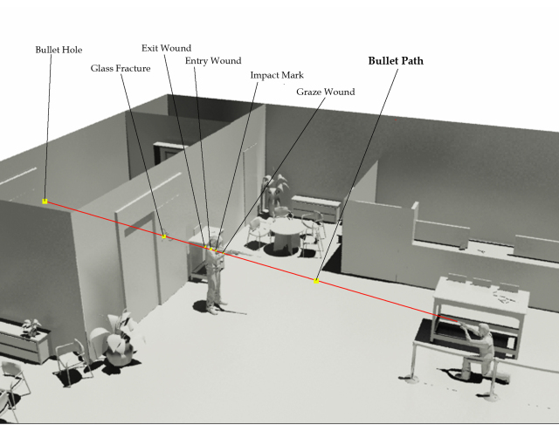
Crime Scene Reconstruction (CSR)
Image Source:
https://sugarmanart.com/2011/05/21/3d-crime-scene-reconstruction/
“
the forensic science discipline that aims to gain explicit knowledge of the series of events that surround the commission of a crime using deductive and inductive reasoning, physical evidence, scientific methods, and their interrelationships
an invaluable component of post-mortem forensic
analysis, providing a more intuitive understanding of the crime

Slide 3
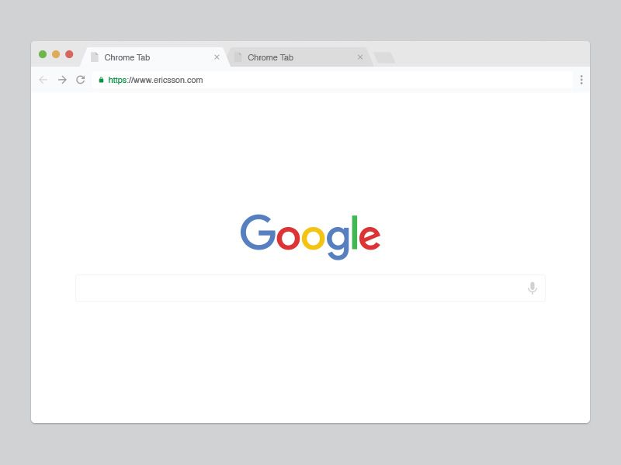






Cyber Crime Scene Reconstruction (C²SR)
“
Reconstructing an execution of an attack delivery process to gain knowledge of the series of cyber events, which we call cybercrime scene.
Attribution
Attribution

Slide 4
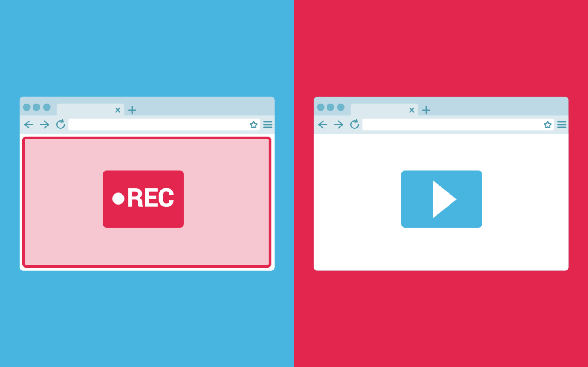
Record and replay
Sounds like a good plan, but …
an exploit often happens during a long-running execution of a complex and concurrent application
analyzing attack delivery process often requires user-interactions on the reconstructed execution
Existing solutions
are not designed to replay a short partial execution of a long and concurrent execution
do not allow user interactions on a replay execution (because user interactions would make the replay execution divert from its recording)

Slide 5
Cyber Crime Scene Reconstruction (C²SR)
Reconstruct (1) partial execution that is (2) interactable
Reconstruct a partial execution of a single autonomous task (e.g., browser tab)
Interacting with the reconstructed execution for debugging is allowed
Key enabling technique
Resource-based execution partitioning
Definition of consistent resource accesses

Slide 6
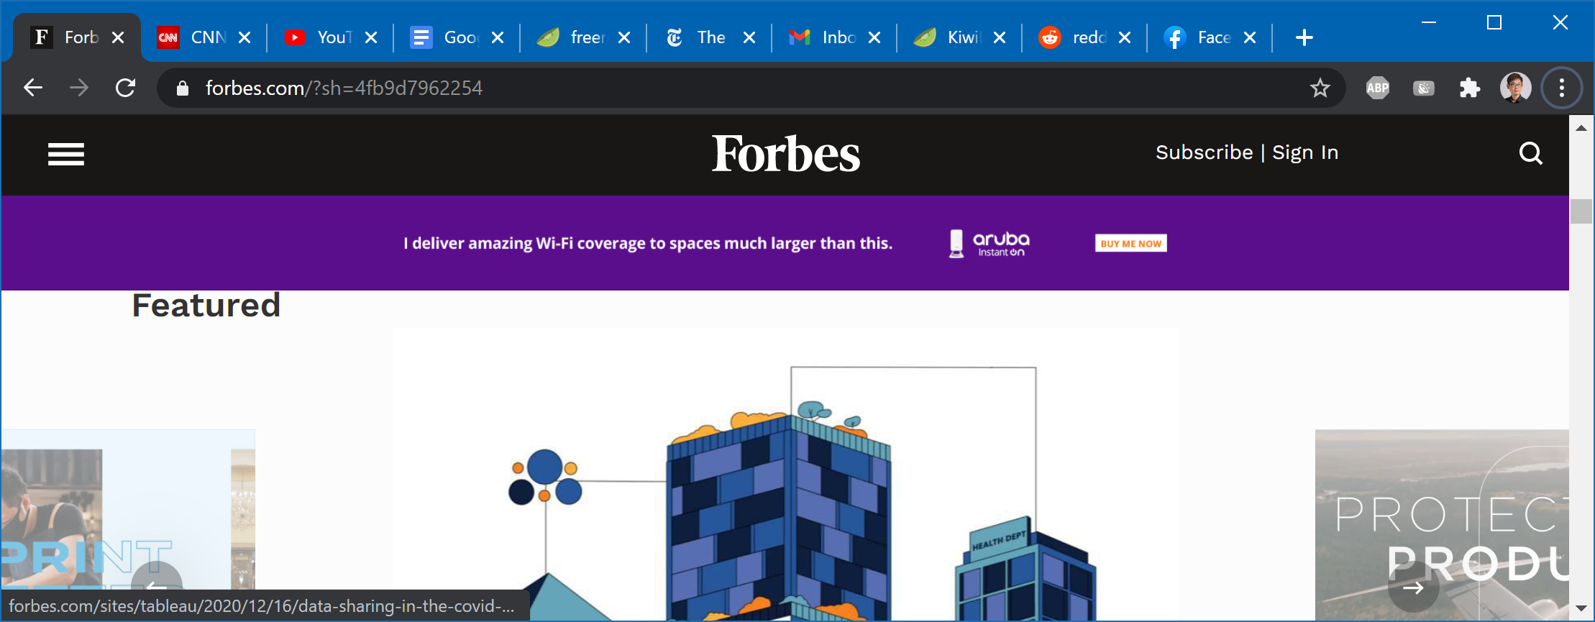
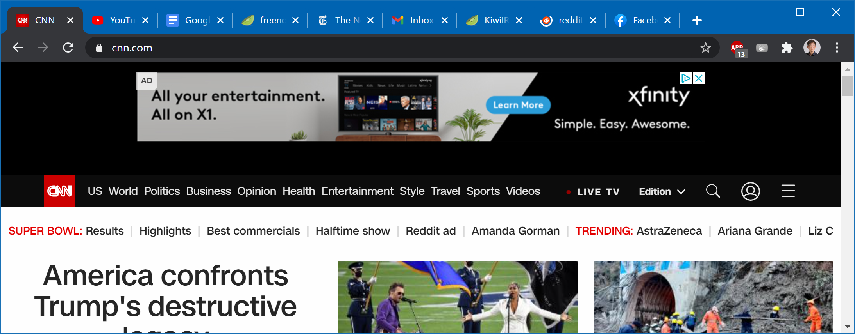
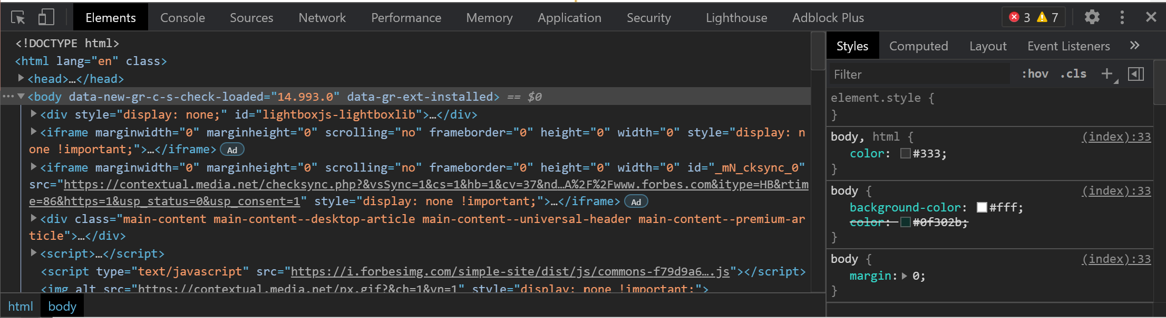
An example: Timeline of 10 browser tabs

Slide 7
An example: Timeline of 10 browser tabs
Region:
2
Tab
1
3
1
*.facebook.com
U1
U2
2
U3
U4
U3
3
U5
U6
U6
4
mail.google.com
*.google.com
*.google.com
5
*.nyt.com
*.nytimes.com
*.krxd.net
6
webchat.freenode.net
U7
U8
U8
7
docs.google.com
U9
U9
8
*.youtube.com
U10
U10
9
*.cnn.com
*.krxd.net
*.krxd.net
U11
10
*.forbes.com
*.moatads.com
*.forbes.com
Malicious Ads
0
…
80
85
90
95
100
Tab 10 Opened
Time (s)
Malicious Ad Launched
Malware Downloaded
Tabs 1-9 Opened
Abbreviated URLs
U1: *.fbcdn.com, U2: *.facebook.com, U3: *.redditstatic.com, U4: *.reddit.com, U5: *.gstatic.com, U6: *.google.com, U7: kiwi.freenode.net, U8: kiwiirc.com, U9: play.google.com, U10: *.googlevideo.com, U11: cdn.cnn.com

Slide 8
Workflow of C²SR
Target Programs
(e.g., web browser)
Legend
Target Program
(e.g., web browser)
Input
Output
Reconstructed Resources
(e.g., files, network streams)
Execution Reconstructor
Reconstructed Execution (i.e., Cybercrime scene)
Recorder
Execution Trace
Resource Reconstructor
Timeline Projector
Recording in Production Run
Resource Reconstruction
Cybercrime Scene Reconstruction
Online
Offline
Offline

Slide 9
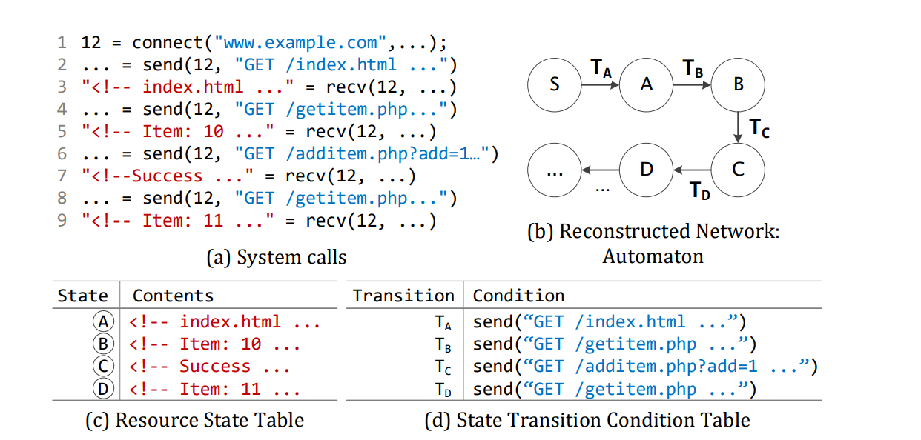
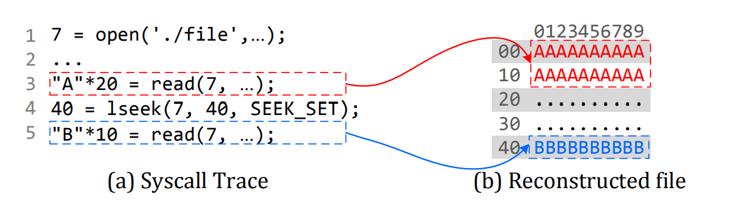
Resource Reconstruction
Random-access resources
Sequential-access resources

Slide 10
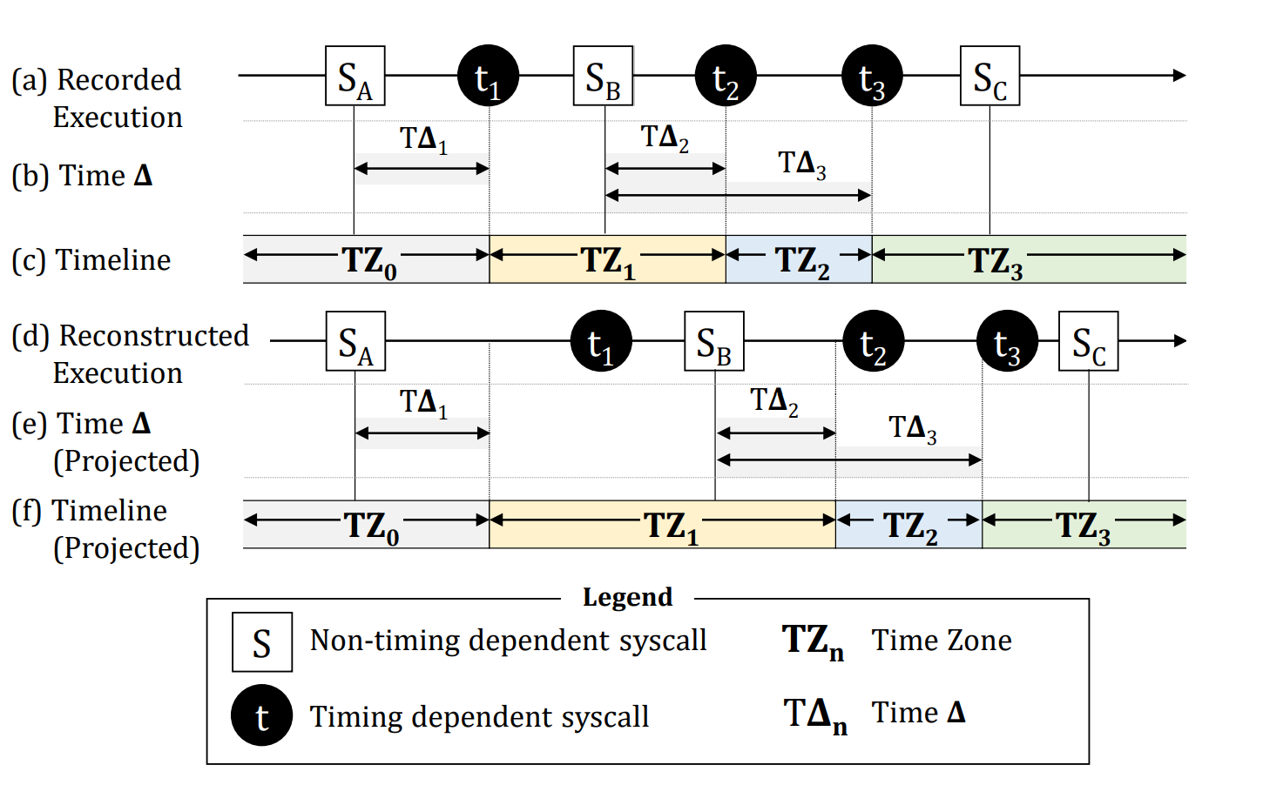
Resource Reconstruction (cont)
Timing dependent resources

Slide 11
Resource Reconstruction: Resource-based Execution Partitioning
Legend
T_{START}
T_{END}
Access to Resource R
Time
Time
Access to Resource B
(a) Execution Trace (No partitioning applied)
(b) Time-sliced Execution Trace (from T_{START} to T_{END})
Access to Resource Y
Access to Resource S
R
Task
B
Resource
X
Y
Y
S
Z
Time
Time
(c) Resource based Execution Partitioning
(Events are partitioned by resources)
(d) Resources Accessed by Each Task
S_{BEGIN}
S_{END}
Time
(e) Partial Reconstructed Execution
(Requested accesses to resources are reproduced. Some resources are accessed partially)

Slide 12
More details in the paper
List of system calls categorized to each resource type: random-access, sequential access, and timing-dependent
Formal definitions for resource-based execution partitioning and reconstruction
What if the timeline reconstruction fails?
Timeline Projection Adjustment (TPA) Algorithm
Example
Attacks against C²SR
An execution with high-degree of non-deterministic events will make the timeline reconstruct difficult
and more …

Slide 13
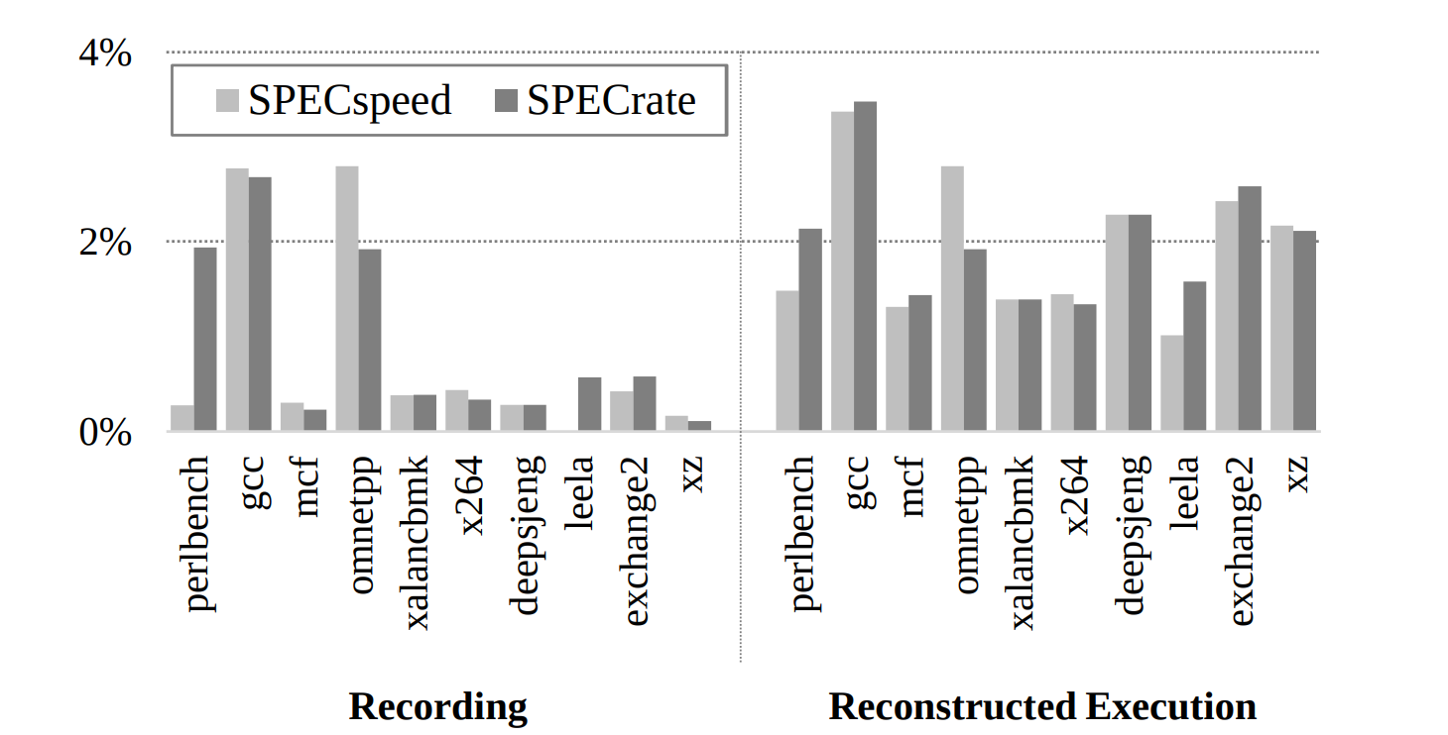
Evaluation: Performance
SPEC CPU2017: 0.8% for recording, 2% for reconstruction

Slide 14
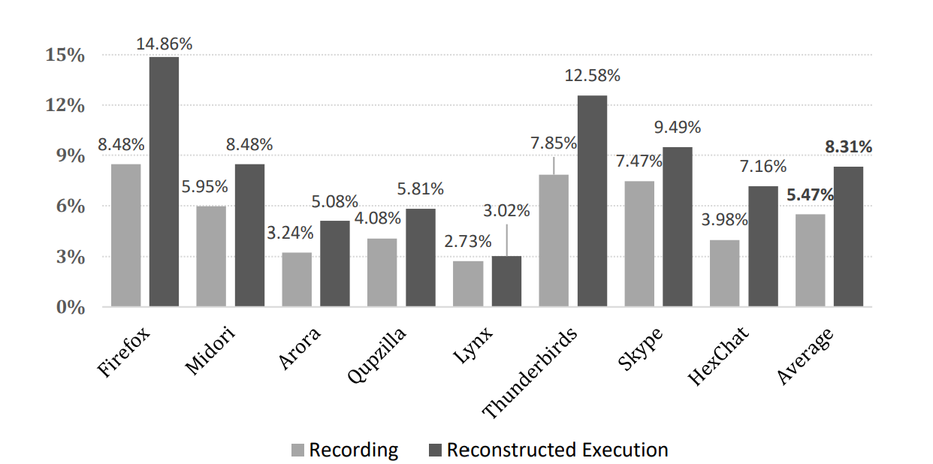
Evaluation: Performance
Client applications: 5.47% for recording, 8.32 for reconstruction

Slide 15
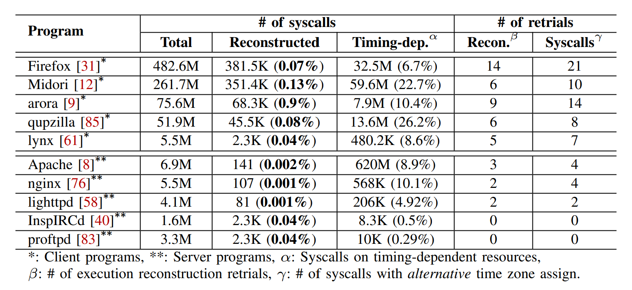
Evaluation: Effectiveness

Slide 16
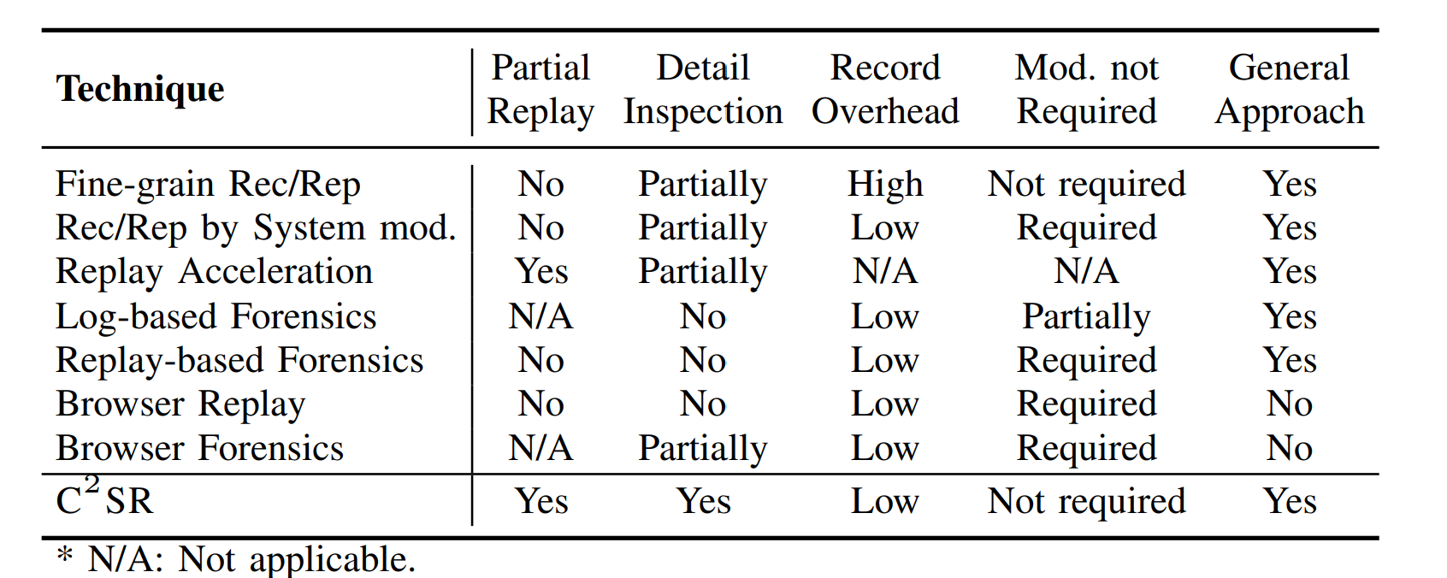
Related work
Record and replay techniques
Deterministic faithful replay
PRES (SOSP’09), ODR (SOSP’09), CLAP (PLDI’13), Strata (ASPLOS’06), …
Forensic analysis
LASER (SOSP’05), Sam. King et al. (SOSP’03), BEEP (NDSS’13), MPI (SEC’17), …
Replay based forensics
Jim et al. (ATC’08), Revirt (OSDI’02), RAIN (CCS’17), Yang et al. (CCS’18), …
Browser-specific approaches
Webcapsule (CCS’15), MugShot (NSDI’10), JSGraph (NDSS’18), ClickMiner (CCS’14), …

Slide 17




Conclusion and Q & A
C²SR enables effective cybercrime scene reconstruction via
Resource-based execution partitioning
Resource reconstruction
It can reconstruct partial execution that is interactable
Yonghwi Kwon, University of Virginia (http://yongkwon.info)
Supported by NSF, ONR, Mozilla, and Facebook.

Slide 18
Case study: Fileless JavaScript Attack
1
2
3
4
5
6
7
8
9
10
11
12
13
14
15
16
WS = new WebSocket('.../mal.js');
WS.onmessage = function (e) {
mal = atob(e.data);
};
function benign_compromised() {
var sc = document.createElement('script');
...
//sc.src = "http://.../benign.js";
sc.appendChild( document.createTextNode( mal ) );
...
document.getElementsByTagName('head')[0] .appendChild(sc);
}
...
<script type='text/javascript'>
// download a malicious binary
</script>
Legend
Code Changed by the Malicious Attacker
Breakpoint to Inspect Program States (e.g., Variables)
C
B

Slide 19
Case study: Fileless JavaScript Attack
1
2
3
4
5
6
7
8
9
10
11
12
13
14
15
16
WS = new WebSocket('.../mal.js');
WS.onmessage = function (e) {
mal = atob(e.data);
};
function benign_compromised() {
var sc = document.createElement('script');
...
//sc.src = "http://.../benign.js";
sc.appendChild( document.createTextNode( mal ) );
...
document.getElementsByTagName('head')[0] .appendChild(sc);
}
...
<script type='text/javascript'>
// download a malicious binary
</script>
Legend
Code Changed by the Malicious Attacker
Breakpoint to Inspect Program States (e.g., Variables)
C
B

Slide 20
Case study: Fileless JavaScript Attack
1
2
3
4
5
6
7
8
9
10
11
12
13
14
15
16
WS = new WebSocket('.../mal.js');
WS.onmessage = function (e) {
mal = atob(e.data);
};
function benign_compromised() {
var sc = document.createElement('script');
...
//sc.src = "http://.../benign.js";
sc.appendChild( document.createTextNode( mal ) );
...
document.getElementsByTagName('head')[0] .appendChild(sc);
}
...
<script type='text/javascript'>
// download a malicious binary
</script>
Legend
Code Changed by the Malicious Attacker
Breakpoint to Inspect Program States (e.g., Variables)
C
B

Slide 21
Case study: Fileless JavaScript Attack
1
2
3
4
5
6
7
8
9
10
11
12
13
14
15
16
WS = new WebSocket('.../mal.js');
WS.onmessage = function (e) {
mal = atob(e.data);
};
function benign_compromised() {
var sc = document.createElement('script');
...
//sc.src = "http://.../benign.js";
sc.appendChild( document.createTextNode( mal ) );
...
document.getElementsByTagName('head')[0] .appendChild(sc);
}
...
<script type='text/javascript'>
// download a malicious binary
</script>
Legend
Code Changed by the Malicious Attacker
Breakpoint to Inspect Program States (e.g., Variables)
C
B

Slide 22
Case study: Fileless JavaScript Attack
1
2
3
4
5
6
7
8
9
10
11
12
13
14
15
16
WS = new WebSocket('.../mal.js');
WS.onmessage = function (e) {
mal = atob(e.data);
};
function benign_compromised() {
var sc = document.createElement('script');
...
//sc.src = "http://.../benign.js";
sc.appendChild( document.createTextNode( mal ) );
...
document.getElementsByTagName('head')[0] .appendChild(sc);
}
...
<script type='text/javascript'>
// download a malicious binary
</script>
C
B
B
Legend
Code Changed by the Malicious Attacker
Breakpoint to Inspect Program States (e.g., Variables)
C
B

